Slide 1
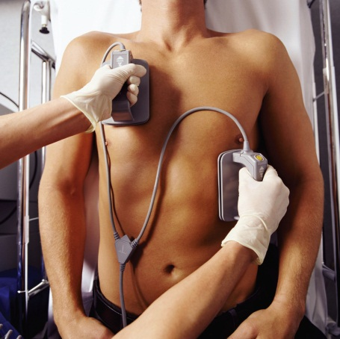
Chapter 26: Capacitance and Dielectrics
Reading assignment: Chapter 26
Homework 26.1 (due Monday, Feb. 25): QQ1, QQ2, 1, 2, 3, 7, 8, 9
Homework 26.2 (due Friday, March 1): QQ3, 13, 14, 16, 17, 19, 23, 25, 27
Homework 26.3 (due Monday, March 4): OQ1, OQ4, OQ5, OQ7, OQ9, OQ10, QQ4, 30, 32, 34, 43, 44, 45, 48
Capacitors – Important element in electric circuits with numerous applications (other elements in circuits are resistors, inductors, diodes, transistors, power sources).
Capacitors are devices that store electric charge (and energy).
Applications: energy/charge storing devices for electric flashes, defibrillator, element in electric circuits – frequency tuners in radios, filters in power supplies, etc.
Can be charged quickly

Slide 2
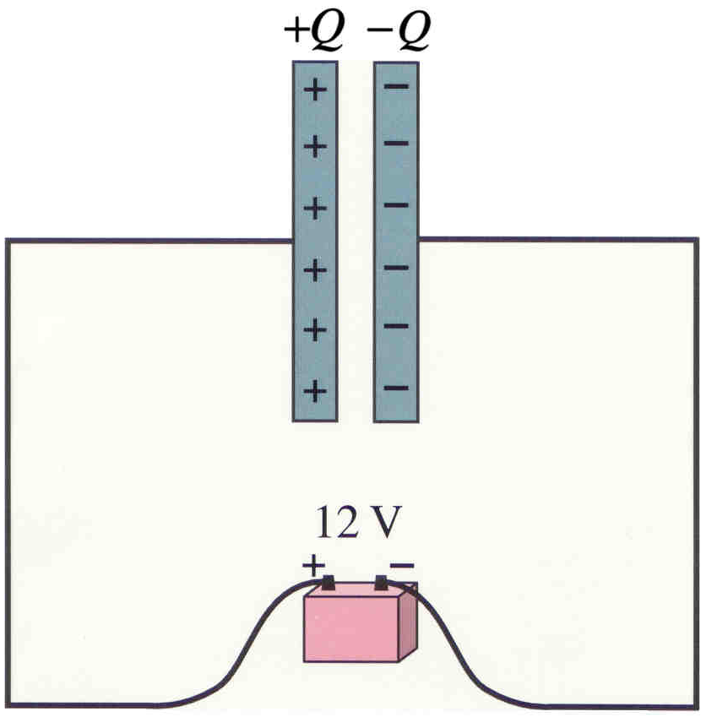
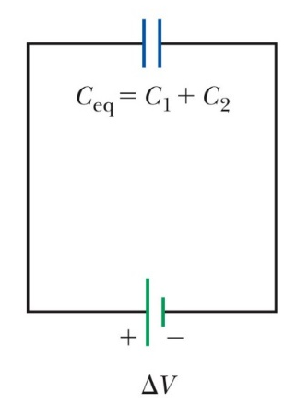
Capacitor
A capacitor is a device that can store electric charge. It usually consists of two conducting plates or sheets placed near each other, but not touching.
One plate carries charge +Q, the other charge -Q
Use: To store charge (camera flash, energy back-up in computers when power fails, circuit protection by blocking surges, others)
Often the plates are rolled in the form of a cylinder.
Symbol of capacitor in a circuit:
Parallel plate capacitor and battery
C
ΔV

Slide 3
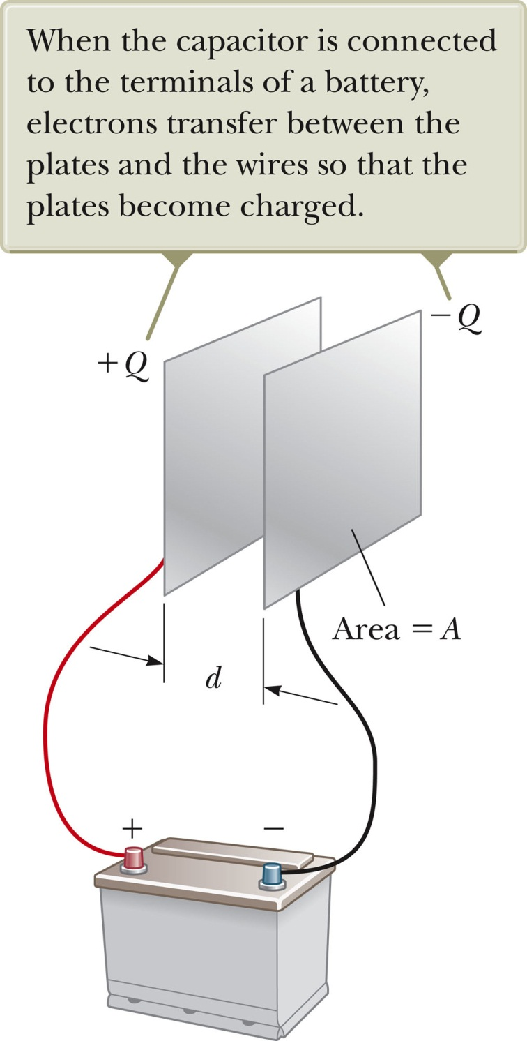
Capacitance
When the capacitor is connected to the terminals of a battery (apply a voltage V to capacitor), the capacitor quickly becomes charged.
One plate negative and the other positive (same amount of charge.
The amount of charge acquired by each plate is proportional to the potential difference (voltage) ΔV between the plates:
The proportionality constant is called the capacitance of the capacitor. The unit is Farad (1F) (Coulomb/Volt).

Slide 4
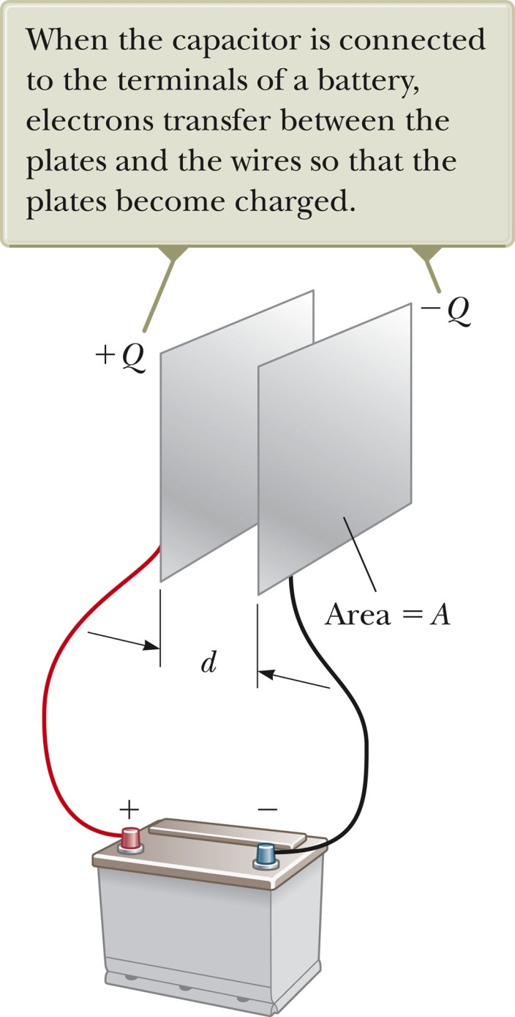
Capacitance
Capacitance of a capacitor is the amount of charge a capacitor can store per unit of potential difference.
The capacitance C is a constant for a given capacitor.
The capacitance does depend on the structure, dimensions and material of the capacitor itself (but not on voltage and charge on capacitor).
For a plate capacitor (plates, area A, separation d), in air, the capacitance is given by:
To get a large capacitance, make the area large and the spacing small (and add a dielectric (see, in a few slides)).

Slide 5
White board example
Capacitor calculations:
Derive the capacitance for a plate capacitor (equation on previous slide)
Calculate the capacitance of a capacitor whose plates are 20 cm x 3.0 cm and are separated by a 1.0-mm air gap.
What is the charge on each plate if the capacitor is connected to a 12-V battery?
What is the magnitude of the electric field between the plates?

Slide 6
i-clicker
A capacitor stores charge Q at a potential difference ΔV. What happens if the voltage applied to the capacitor by the battery is doubled to 2 ΔV?
The capacitance falls to half its initial value and the charge remains the same.
The capacitance and the charge both fall to half their initial values.
The capacitance and the charge both double.
The capacitance remains the same and the charge doubles.

Slide 7
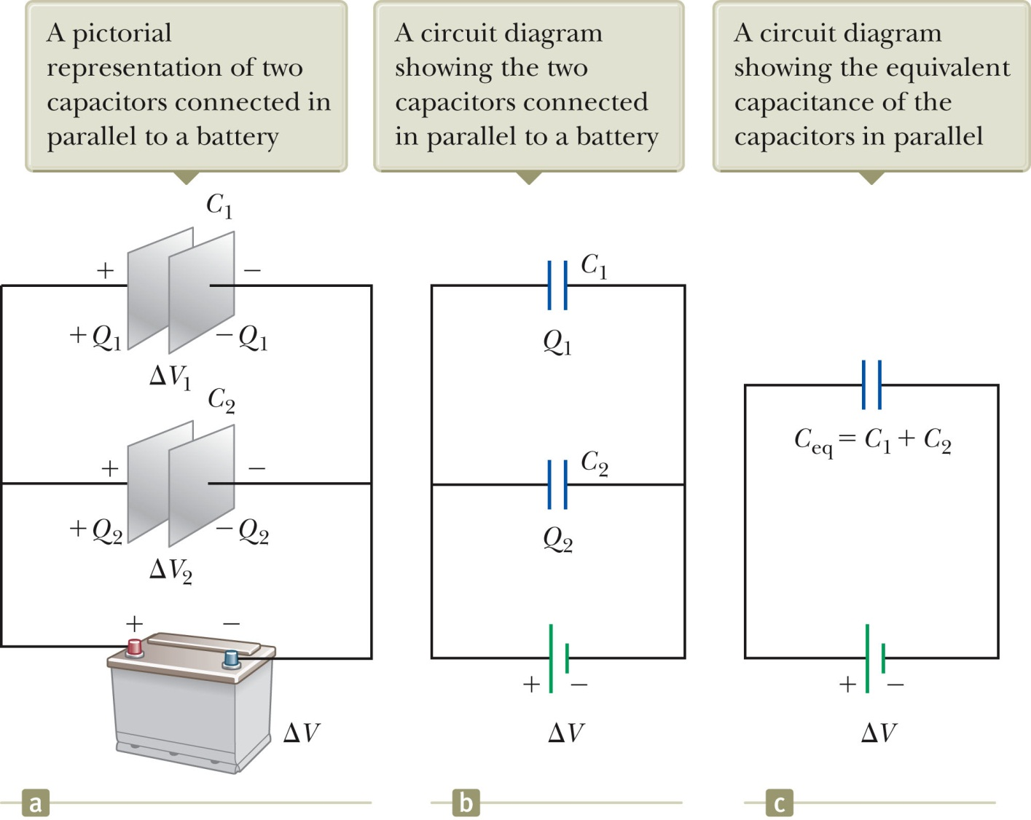
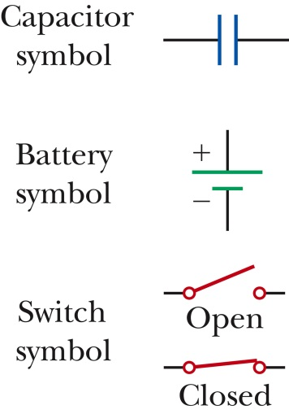
Circuit Analysis: Combinations of Capacitors in a circuit
Parallel Capacitors
Parallel capacitors act like a single capacitor with capacitance:
Same ΔV across both capacitors
When capacitors are connected like this at both ends, we say they are connected in parallel.

Slide 8
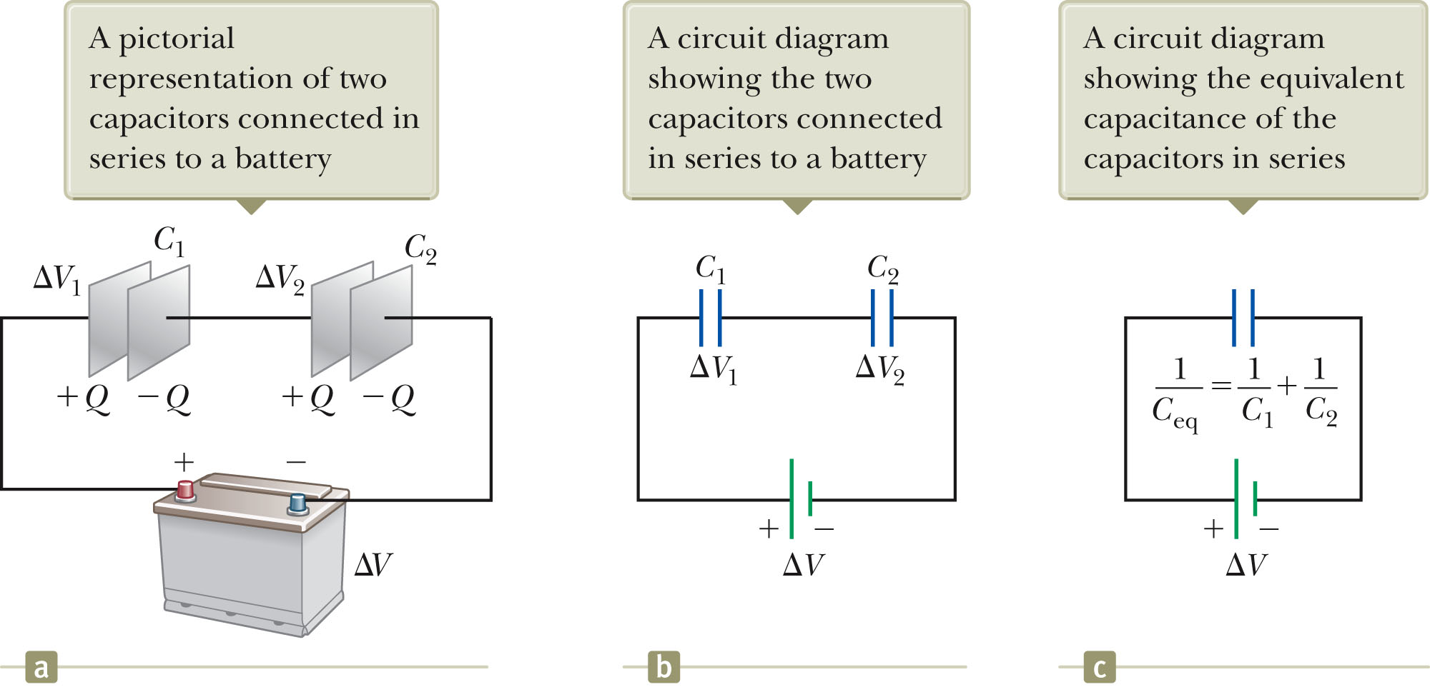
Circuit Analysis: Combinations of Capacitors in a circuit
In series Capacitors
Same charge Q on both capacitors
When capacitors are connected like this at one ends, we say they are connected in series.
In series capacitors act like a single capacitor with capacitance:

Slide 9
White board example (circuit analysis):
Two capacitors C₁ = 5.00 μF and C₂ = 12.0 μF are connected in parallel, and the resulting combination is connected to a 9.00 V battery.
What is the value of the equivalent capacitance of the combination?
What are the potential differences across each capacitor?
What are the charges on each capacitor?
Repeat for capacitors that are connected in series.

Slide 10
i-clicker
When we close the switch, how much charge flows from the battery?
36 μC
4 μC
18 μC
8 μC
10 μC
2 V
3 μF
6 μF
i-clicker
When we close the switch, which capacitor gets more charge Q on it?
The one with the bigger capacitance
The one with the smaller capacitance
They get the same amount of charge
Insufficient information
ΔV₁
ΔV₂
+Q
-Q
+Q
-Q
ΔV
C₁
C₂

Slide 11
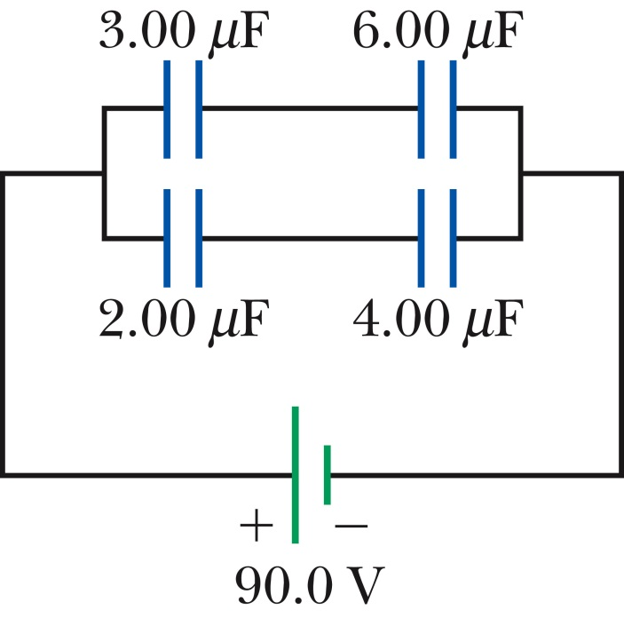
Circuit Analysis: Complicated Capacitor Circuits
For complex combinations of capacitors, you can replace small structures by equivalent capacitors, eventually simplifying everything.
White board problem
For the system of four capacitors shown in the figure find
The equivalent capacitance of the system
The charge on each capacitor
The potential difference across each capacitor

Slide 12
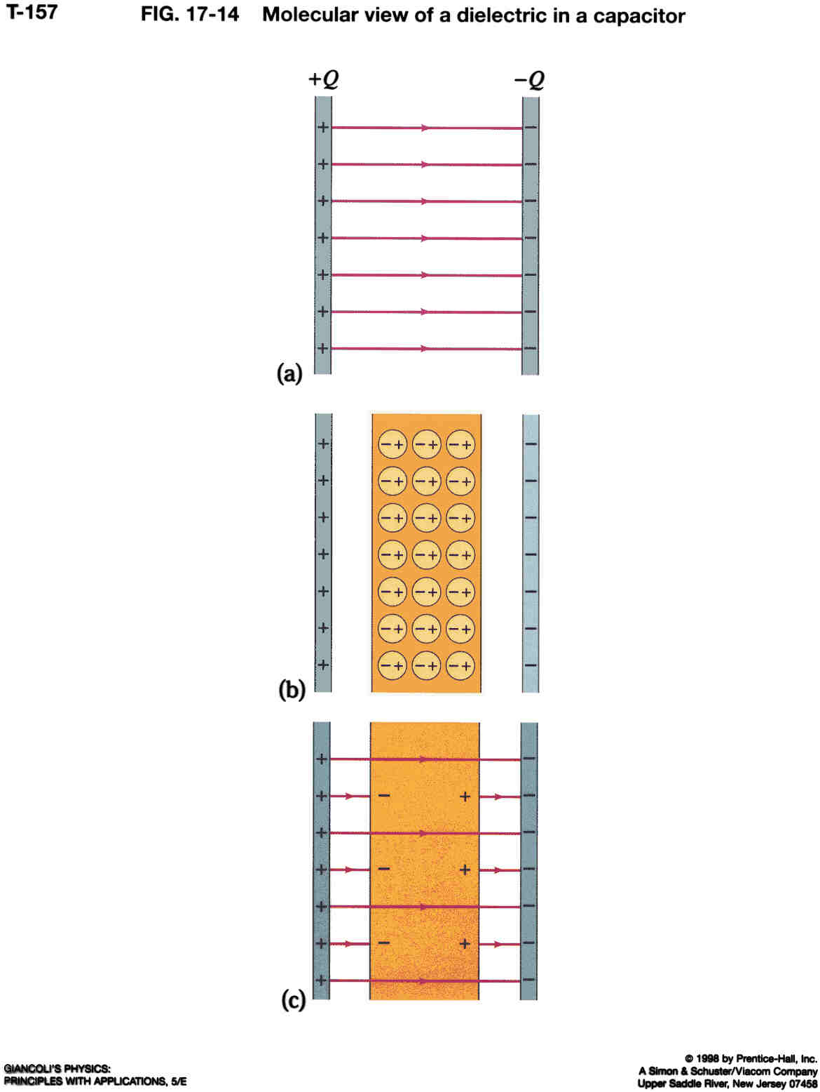
Dielectrics
In most capacitors there is an insulating sheet, called a dielectric, between the plates.
Can apply higher voltage without charge passing through the gap (sparks in air at high voltages).
Plates can be placed closer together (sandwich), thus increasing the capacitance, because d is less.
By placing a dielectric between the gap, the capacitance is increased by a factor κ (κ is dielectric constant).
This can also be written as:
Where
ε is the permittivity of the material

Slide 13
Molecular view of dielectric effect
Consider isolated capacitor (not connected to battery for now):
in air: Q = C₀·V₀ (subscript ‘0’ means before dielectric is inserted)
- Inserting a dielectric (polar molecules)⁺, in which one part of the (neutral) molecule is positive and the other is negative (e.g. H₂O).
- The molecules will become oriented in the field.
- Net effect: Net negative charge on the outer edge of the dielectric material where it meets the positive plate and a net positive charge where it meets the negative plate.
- Electric field passing through the dielectric is reduced by a factor of κ.
- The voltage (work per unit charge) must therefore also have decreased by a factor κ. The voltage between the plates is now:
The charge Q on the plates has not changed, because they are isolated (no battery connected). Thus, we have:
where C is the capacitance when the dielectric is present.
Combining those two equations:
Thus, the capacitance is increased by a factor of κ, when dielectric is inserted.
⁺ The molecules could also be non-polar. In this case the electric field moves the charge on the molecule and induces polarization in the molecule

Slide 14

Capacitor with dielectric, connected to battery
Dielectric
Inserting a dielectric at constant voltage (connected to battery):
A capacitor consisting of two plates separated by a distance, d, is connected to a battery of voltage, V, and acquires a charge, Q.
While it is still connected to the battery, a slab of dielectric material is inserted between the plates of the capacitor. Will Q increase, decrease or stay the same?
+Q
-Q
ΔV
- Connected battery → voltage stays constant, V = V₀
- C must increase when dielectric is inserted, C = κC₀
- Q = C·ΔV, if V is constant, C increases, Q also must increase, Q = κQ₀.
With connected battery: As the dielectric is inserted more charge will be pulled from the battery and deposited onto the plates of the capacitor as its capacitance increases.

Slide 15
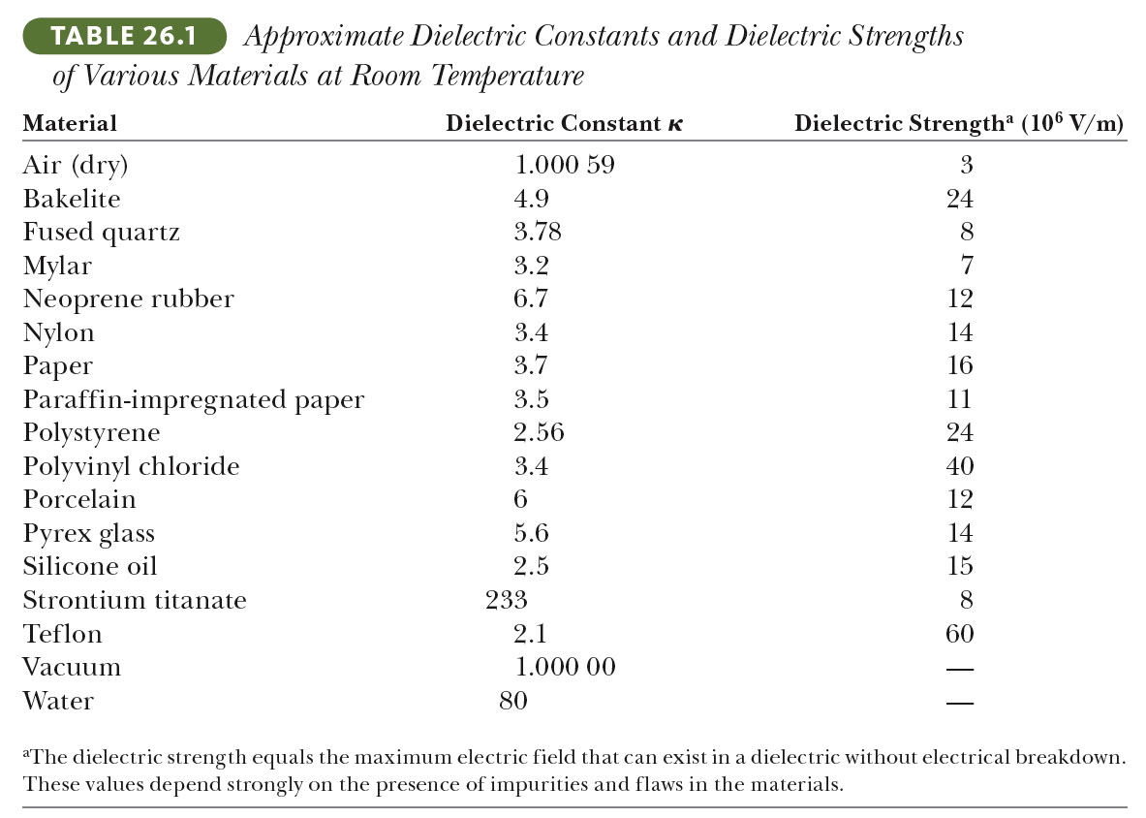
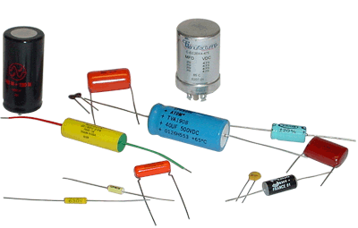
What makes a good dielectric?
Have a high dielectric constant κ
    The combination κε₀ is also called ε, the permittivity
Must be a good insulator
    Otherwise charge will slowly bleed away
Have a high dielectric strength
    The maximum electric field at which the insulator suddenly (catastrophically) becomes a conductor
  There is a corresponding breakdown voltage where the capacitor fails
To build a capacitor with a large capacitance:
Use dielectric with large κ.
Small d.
Several capacitors in parallel.

Slide 16
Storage of electric energy on a capacitor
A charged capacitor stores electric energy
Charging a capacitor takes energy and time. The energy is coming from the battery.
The energy stored in a charged capacitor is given by:
ΔV
Derive on white board

Slide 17
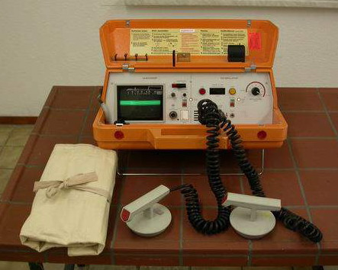
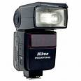
White board example.
Energy stored in a capacitor. Capacitors often serve as energy reservoirs that can be slowly charged, and then quickly discharged to provide large amounts of energy in a short pulse (e.g. camera flash, defibrillator).
A camera unit stores energy in a 150 μF capacitor at 200V. How much electric energy can be stored?
(One AAA battery can store about 3000 J of electric energy).
C = 150 μF
ΔV = 200V

Slide 18
Energy in a capacitor
Two i-clickers.
For the circuits below, which of the two capacitors gets more energy in it?
The 1 μF capacitor.
The 2 μF capacitor.
Equal energy.
20 V
20 V
1 μF
2 μF
1 μF
2 μF
Capacitors in series have the same charge Q
Capacitors in parallel have the same voltage difference ΔV

Slide 19
i-clicker
A parallel-plate capacitor is attached to a battery that maintains a constant potential difference ΔV between the plates. While the battery is still connected, a glass slab is inserted so as to just fill the space between the plates. The stored energy
increases
decreases
remains the same.
i-clicker
Consider a simple parallel-plate capacitor whose plates are given equal and opposite charges and are separated by a distance d (no battery attached). Suppose the plates are pulled apart until they are separated by a distance D > d. The electrostatic energy stored in the capacitor after pulling the plates apart is
greater than
the same as
smaller than
before the plates were pulled apart.

Slide 20
White board example.
Determine the (a) capacitance and (b) the maximum voltage that can be applied to a Teflon-filled parallel plate capacitor having a plate area of 1.75 cm² and insulation thickness of 0.0400 mm. κ for Teflon is 2.1 and its dielectric strength is 60 x 10⁶ V/m.
ΔV

Slide 21
Energy density (in a capacitor)
Suppose you have a parallel plate capacitor with area A, separation d, and charged to voltage ΔV.
(1) What’s the energy density (energy divided by the volume, V) between the plates?
(2) Write this in terms of the electric field magnitude.
Energy density is energy over volume, V
A
d
We can associate the energy with the electric field itself
This formula can be shown to be completely generalizable
  It has nothing in particular to do with capacitors

Slide 22
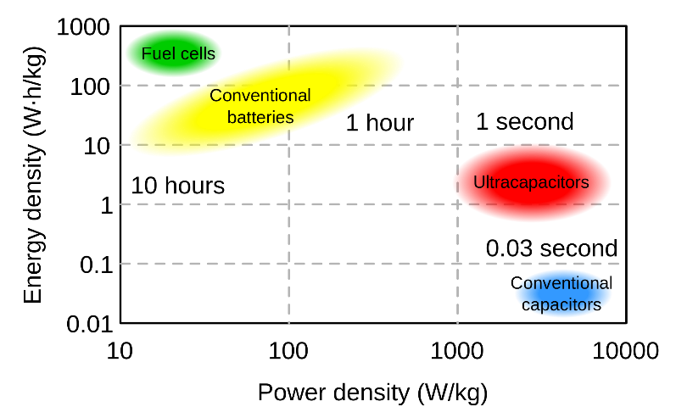
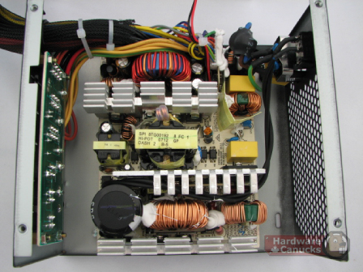
What are capacitors good for?
They store energy
    The energy stored is not extremely large, and it tends to leak away over time
    Gasoline, fuel cells (fuel to electricity) or batteries are better for this purpose
They can release their energy very quickly
    Camera flashes, defibrillators, research uses
They resist changes in voltage
    Power supplies for electronic devices, etc.
They can be used for timing, frequency filtering, etc.
    In conjunction with other parts
Power = Energy/time.
Image from Wiki Commons

Slide 23
Review:
Definition of capacitance:
Plate capacitor:
Know some potential uses for capacitor (to store charge, to store energy, quick release of energy)
Multiple capacitors:
  Parallel: voltage drop is same, and
  In-series: charge on capacitors is the same, and
  Know how to analyze capacitor circuits with multiple capacitors on parallel and in series, and how to simplify them (equivalent capacitance, voltage drop across subsection, charge on multiple capacitors.
Dielectric; understand their molecular structure (polar), they increase the capacitance of a capacitor by a factor of κ (dielectric constant).
Dielectric in capacitor.
  With battery connected (ΔV (and E) are constant, C = κC₀, Q = κQ₀, U = κU₀)
  Battery disconnected (Q is constant, C = κC₀, , ΔV = ΔV₀/κ, E = E₀/κ, U = U₀/κ)
The energy stored in a capacitor (three different equations):
Energy density (energy per volume):

Slide 24
Extra Slide for practice
i-clicker
Which is true?
The capacitance of a parallel plate capacitor increases as the voltage across it increases
The charge stored by a capacitor increases as the voltage across it increases.
The voltage across two capacitors in series is the same for each.
i-clicker
Two capacitors C₁ and C₂ are connected in a series connection. Suppose that their capacitances are in the ratio C₂/C₁ = 2/1. When a potential difference, ΔV, is applied across the capacitors, what is the ratio of the charges Q₂ and Q₁ on the capacitors? Q₂/Q₁ =
2
1
½
none of the above
Need more information
i-clicker
For the capacitors above the ratio of the voltage drops across each one is V₂/V₁ =
2
1
½
none of the above
Need more information

